Slide 1
Emergence of Bangladesh
North South University
DEPT. OF HISTORY & PHILOSOPHY
Dhaka, Bangladesh
HIS 103

Slide 2
Permanent Settlement of 1793

Slide 3
HISTORICAL BACKGROUND & IMPORTANCE:
The most momentous decision of the early colonial period was the creation of a new system of land taxation which came to be known as the ‘permanent settlement’. Introduced in 1790 and codified in 1793, it was important because it was more than merely a tax system.
It formed the nucleus of the colonial system of control; other parts of the administration such as the executive, the judiciary and the police were geared to the desired working of the permanent settlement.
It survived with modifications till the 1950s and moulded social and economic relations in the Bengal delta to such an extent that contemporary Bangladesh society cannot be understood without reference to it (Schendel, 2010).

Slide 4
PROBLEMS & ISSUES:
The BEIC introduced several measures to increase its share of revenue. Warren Hastings initiated a temporary 5-year term settlement which was later reduced to a 1-year term. In the meantime, Lord Cornwallis was appointed as a new Governor General for Bengal in 1786. He was in favor of a permanent settlement to secure a stable basis for revenue earning. To this end, he introduced a 10-year settlement.
So, the Permanent Settlement was first introduced in Bengal by Lord Cornwallis in 1793 and later extended to parts of Bihar, Orissa and Madras. It has been claimed by many (including Marxists) that by introducing the zamindari system, the British created a feudal class in India.

Slide 5
The Permanent Settlement (PS) was a grand contract signed in 1793 between the government of the East India Company in Bengal and individual landholders of Bengal- zamindars and talukdars. Under the contract, the zamindars were admitted into the colonial state system as the absolute proprietors of landed property in Bengal. The government revenue payable to government was fixed permanently. The rules of the permanent settlement made every individual zamindar and talukdar the permanent and absolute proprietors of the land under their control.
As absolute proprietors of land, zamindars and talukdars were required to pay revenue to government at a rate fixed permanently. But the cultivating raiyats were denied to such a privilege. The landholders were free to change the rent rate of their tenants. They even could evict their tenants if they wanted to. But if they defaulted, their lands proportionate to their default would be realised through public sale of their land. This strong law was called the Sun-set Law.

Slide 6
Objectives/Goals:
To increase the revenue of the BEIC;
To secure a permanent base for revenue collection;
To create a subservient class loyal to and supportive of the British colonial rule ; and
To create an aristocracy following the European model
To apply the colonial policy of “Divide & Rule”.

Slide 7
Exploitative Land Management System :
In real judgment, the Permanent Settlement was nothing but an instrument of the BEIC’s exploitative control over the land management, and thereby, over the peasant economy of Bengal.
Crushing changes in the agrarian structure were taking place after the Permanent Settlement
The problem of the rise of hierarchic intermediate classes in land control had, indeed, deep economic and social implications

Slide 8
Emergence of a Centralized Administrative System:
The bureaucracy and the army recruit their senior officers largely from rich rural families and therefore the landowning classes have a built-in position within the oligarchy. The bureaucrats have a direct stake in the privileges of the landed classes. This link has been greatly reinforced by the grant of land to civilian and military officers, who have thereby become substantial landowners in their own right when they were not so already.

Slide 9
Growth in Agriculture:
Instead of improving land by means of capital and organizational input, the strategy of the zamindars was to increase income by other more profitable means such as mahajani investment, grain trade, purchase of new estates, bonds, urban properties, and enhancing rent and imposing illegal rents on raiyats/farmers.

Slide 10
POLITICS: WHO GETS WHAT, WHEN & HOW ?
Pluralistic
Power Structure
Ideological
Power Structure
Monolithic
Power Structure

Slide 11
Structural Changes :
Change in rural power structure
Change in urban power structure
Change in land ownership pattern
Change in income
Change in consumption
Change in life-style
Change in the pattern of revenue collection

Slide 12
EMERGENCE OF A NEW MIDDLE CLASS:
Professor Amalendu De in his article, entitled, ‘Bengali Intelligentsia’s Attitude to the Permanent Settlement’, published in a journal named Social Scientist ( Vol.5, No. 8, 1977) commented as follows:
“As a result of the alliance of British rule with landlordism a new 'social basis' was created in Bengal. Within a few years of its introduction the Permanent Settlement had stimulated sub-infeudation. It became a marked feature in the land system of Bengal by 1806-1807. One of the objectives of the Permanent Settlement was stated to be the creation of the Bengali middle class. By 1930 its existence became distinctly visible as a social force”.

Slide 13
In his book, entitled, The Permanent Settlement in Bengal-A Study of its Operations 1790-1819 , professor Serajul Islam observed as follows:
“Economically it was expected that the permanent settlement would encourage the investment of capital in land and, therefore, the growth of a middle class; that it would lead to more lenient and considerate treatment of the tenants by the landlords and would thus promote general prosperity”.

Slide 14
PEASENT UNREST, RENT COMISSION & BENGAL TENANCY ACT OF 1885:
Mounting peasant unrest in the 1870s
A rent commission was set up in 1879 to investigate the tense landlord-tenant relations
The recommendations emerged from the rent commission were incorporated in the Bengal Tenancy Act of 1885
The Bengal Tenancy Act of 1885 for the first time tried to define the rights of various interests in land from the highest proprietor to the lowest cultivating raiyat. Indeed, the act considerably curtailed zamindari power and privileges. This Act had successfully established peace in the countryside.

Slide 15
The rise of proja or peasant property through the successive Rent Act of 1859, Bengal Tenancy Act of 1885, Tenancy Amendment Act of 1928 and the Amendment Act of 1938 introduced new elements in the organizational structure of traditional peasant farming

Slide 16
PEASANT POLITICS & THE FORMATION OF THE KRISHAK PRAJA PARTY UNDER THE LEADERSHIP OF SHER-E-BANGLA A.K. FAZLUL HUQ:
Zamindari sanction and permissions needed to transfer lands
Peasant agitation began again in the 1920s
Under the Amendment Act of 1928 the raiyats got the rights to transfer lands without permission of landholders but they were still subject to pay salami and landlord's had still the right to preemption. They also got the right to cut trees and dig tanks and ponds and construct pucca structures without taking zamindari permission
With the enactment and implementation of the India Act of 1935 the peasant politics had received a fresh stimulus. Peasant grievances were articulated by the political parties. A new political organisation, krishak praja party (KPP) was formed in Bengal with the avowed objects of serving the interests of the praja class mainly and its leader Sher-e-Bangla ak fazlul huq, who politically committed himself to abolishing the permanent settlement if voted to power, had actually formed the government in 1937.

Slide 17
LAND REVENUE COMMISSION & TEBHAGA AGITATION:
Soon after, the Huq ministry formed a committee called Land Revenue Commission (generally known as FLOUD COMMISSION after the name of its chairman Francis Floud) with specific terms of reference concerning the end of the permanent settlement
FLOUD COMMISSION in its 1940 report recommended the abolition of the permanent settlement

Slide 18
ABOLITION OF THE PERMANENT SETTLEMENT IN 1950:
The East Bengal State Acquisition and Tenancy Bill, 1950 was passed in the East Bengal Legislative Assembly .
On 16 December 1950, the bill became on act entitled east bengal state acquisition and tenancy act 1950. Under the act, the permanent settlement was at last abolished. The raiyats, now called maliks or proprietors of land, became direct tenants under the government.

Slide 19
Colonial Legacy of Land Disputes in Bangladesh, 1971-2023:
The annual number of land litigation pending with major courts are 1.4 million and 120 million people are affected by land related disputes. It is further observed that land related cases need an average of 9.5 years for settlement ( Rahman & Hossain, 2020, p.2).
The absence of land governance in terms of poor transparency, accountability and the rule of law encourages corruption.

Slide 20
REFERENCES:
Willem van Schendel, A History of Bangladesh ( Cambridge University Press, Cambridge, 2010)
Serajul Islam , The Permanent Settlement in Bengal-A Study of its Operations, 1790-1819 ( Bangla Academy, Dhaka, 1979)
Ashikur Rahmanan and Rafi Hossain, “The uncomfortable truth about land disputes in Bangladesh: Insights from a household survey, Land Use Policy, Volume 95, June 2020, https://doi.org/10.1016/j.landusepol.2020.104557
Saleh Shahriar, “Review of The Numbers and Narratives of Bangladesh’s Economic Development” , South Asia Economic Journal, Vol. 52, No. 2, 2021, pp. 250-253; available at https://journals.sagepub.com/doi/abs/10.1177/13915614211034256

Slide 21
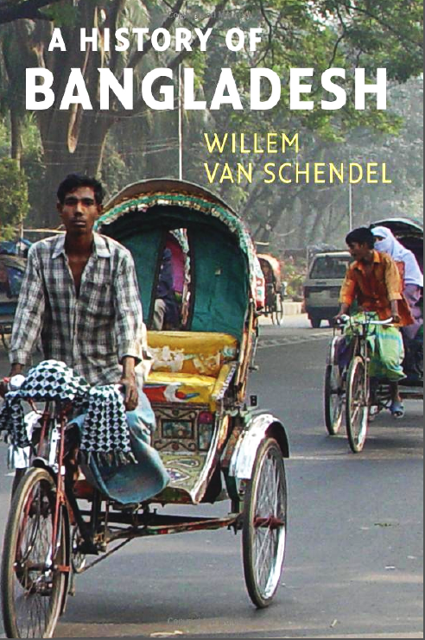

Slide 22
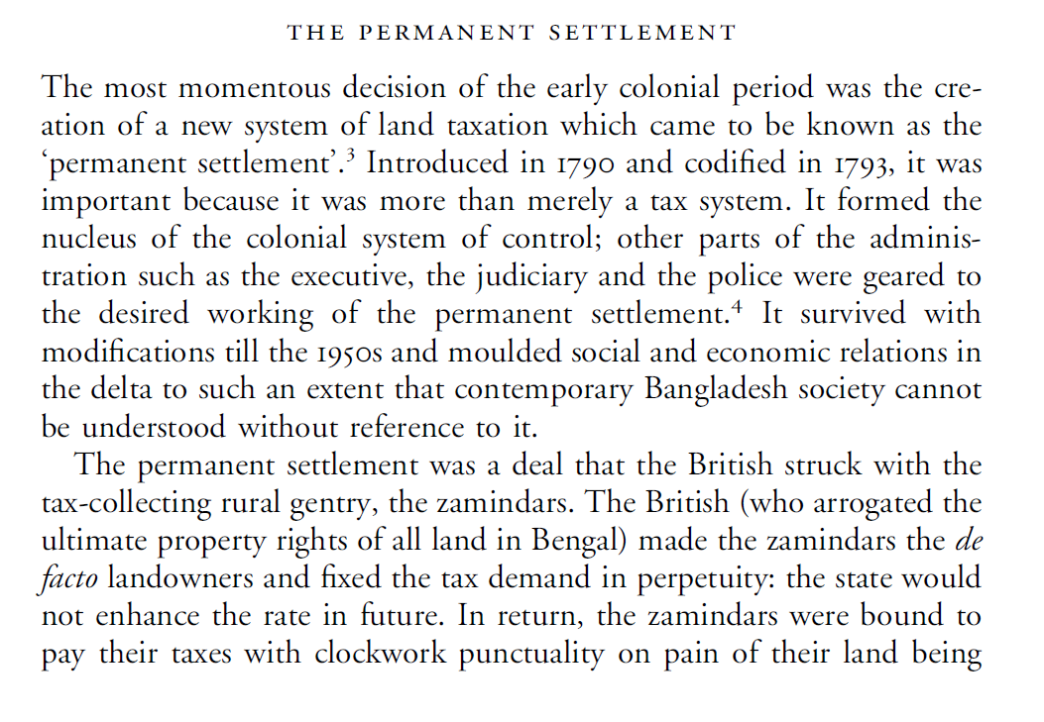

Slide 23
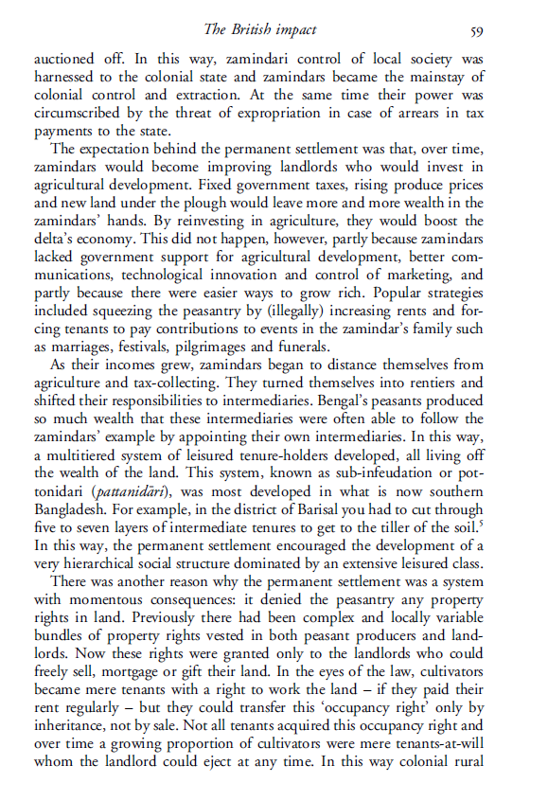

Slide 24
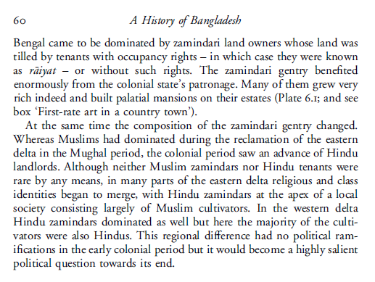

Slide 25
THANK YOU !

